Slide 1
Operational data analysis on Dognition By Junbo Wang
Analyze the dataset with over 140,000 records using Tableau, and give 3 detailed suggestions on how to increase the number of tests completed by Dognition's users.

Slide 2
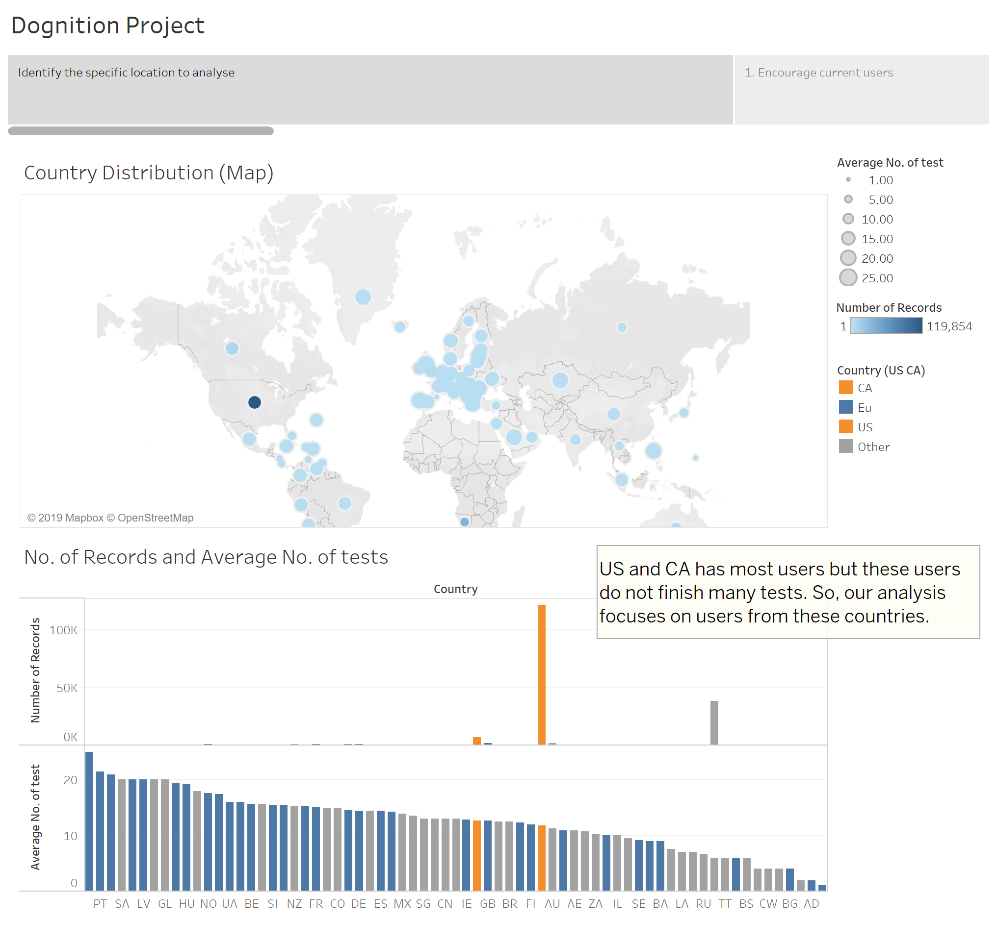

Slide 3
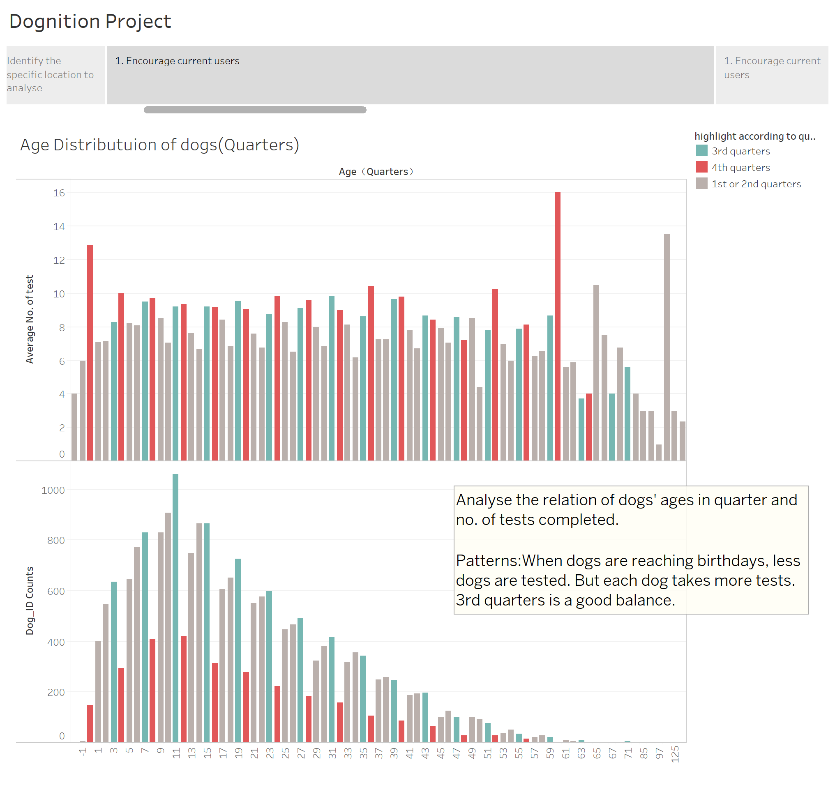

Slide 4
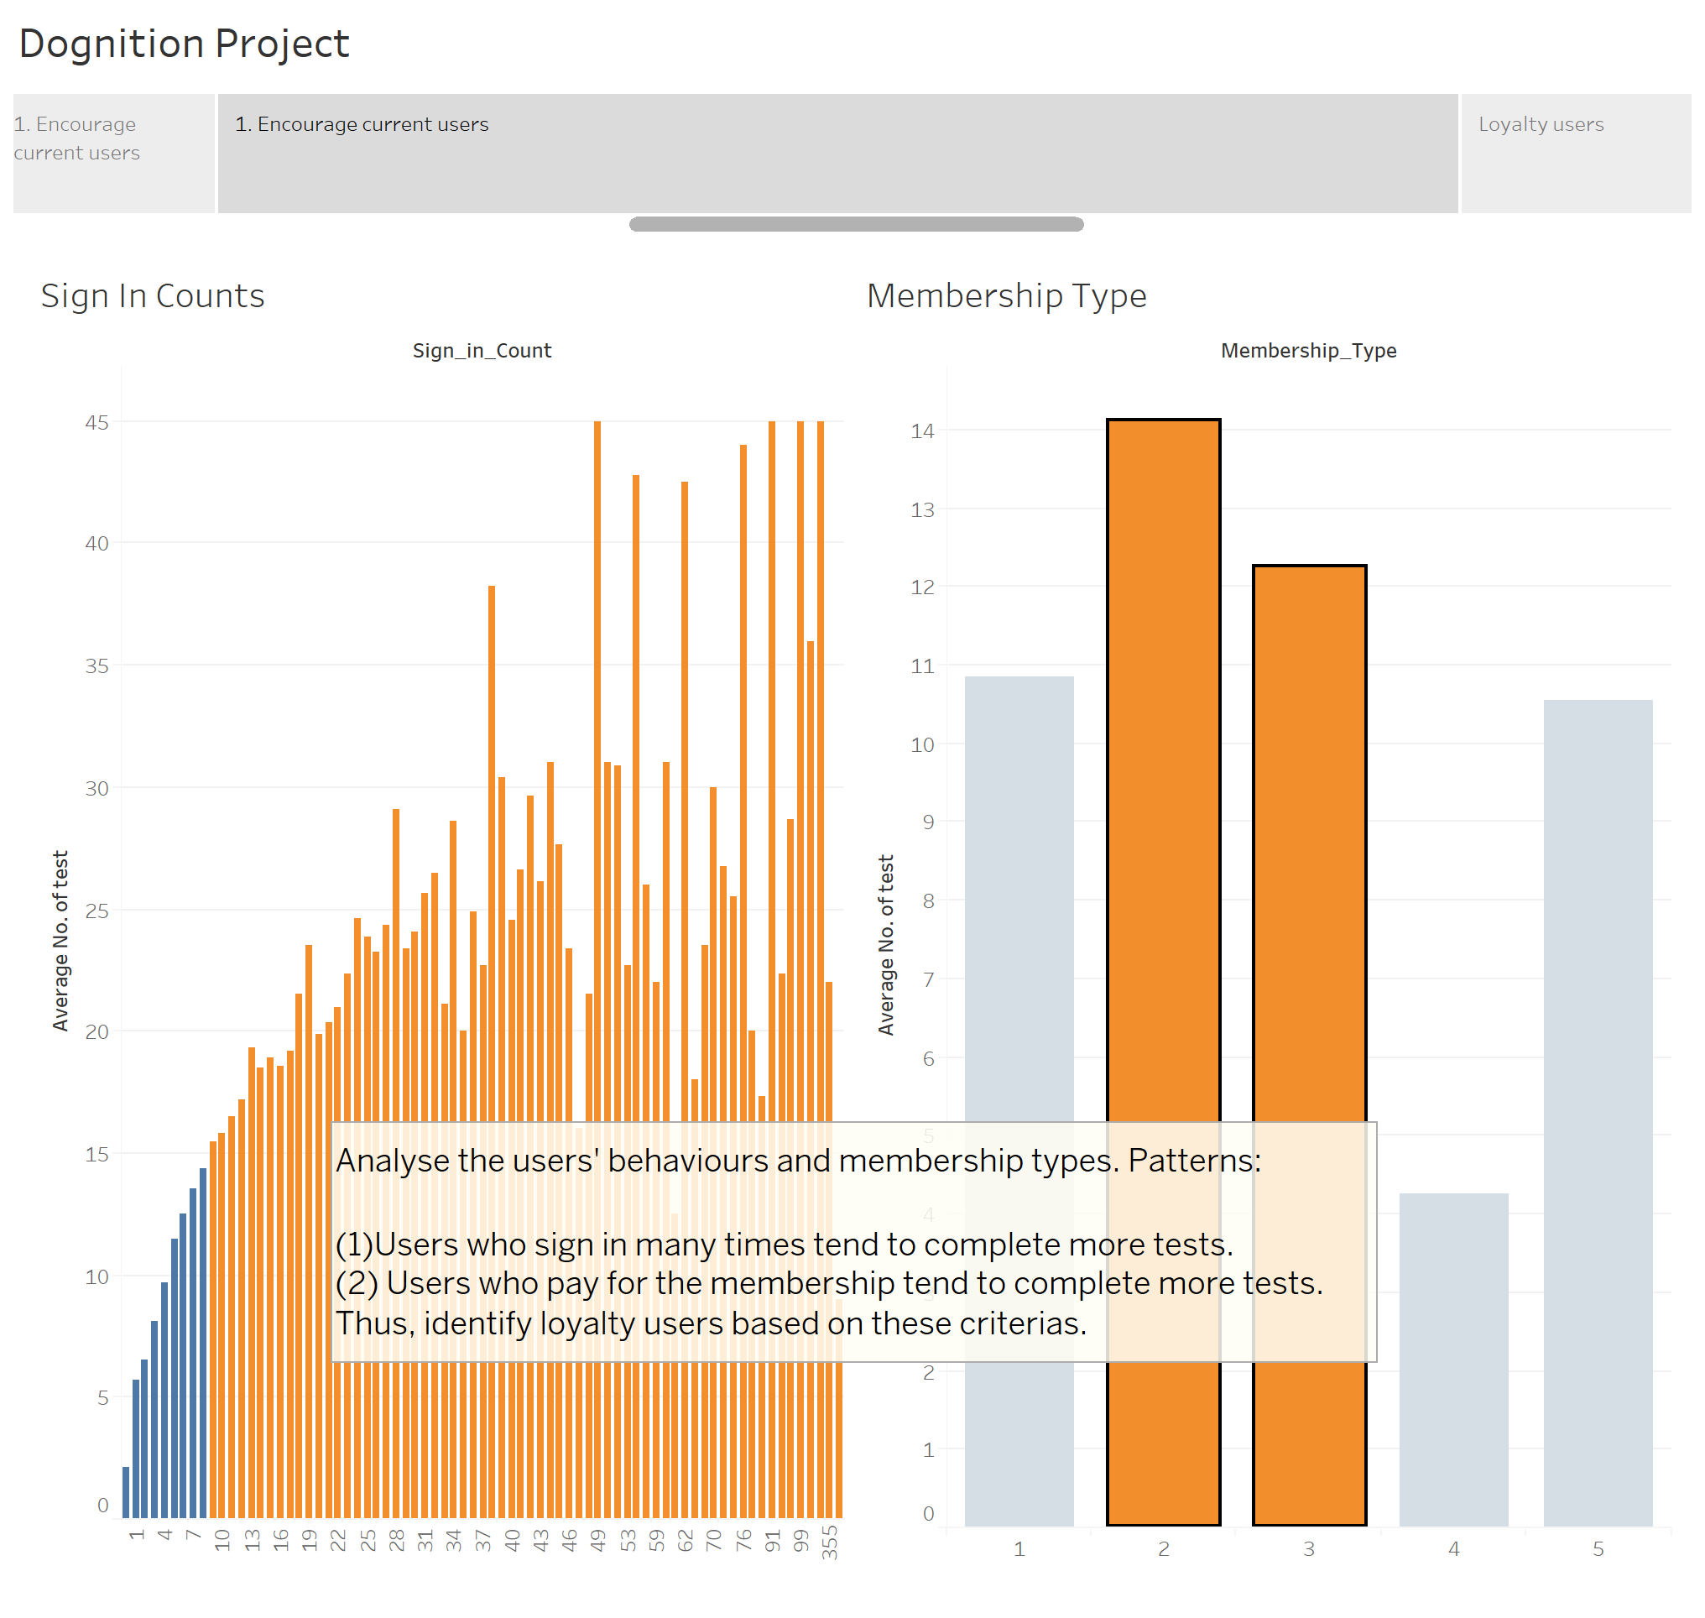

Slide 5
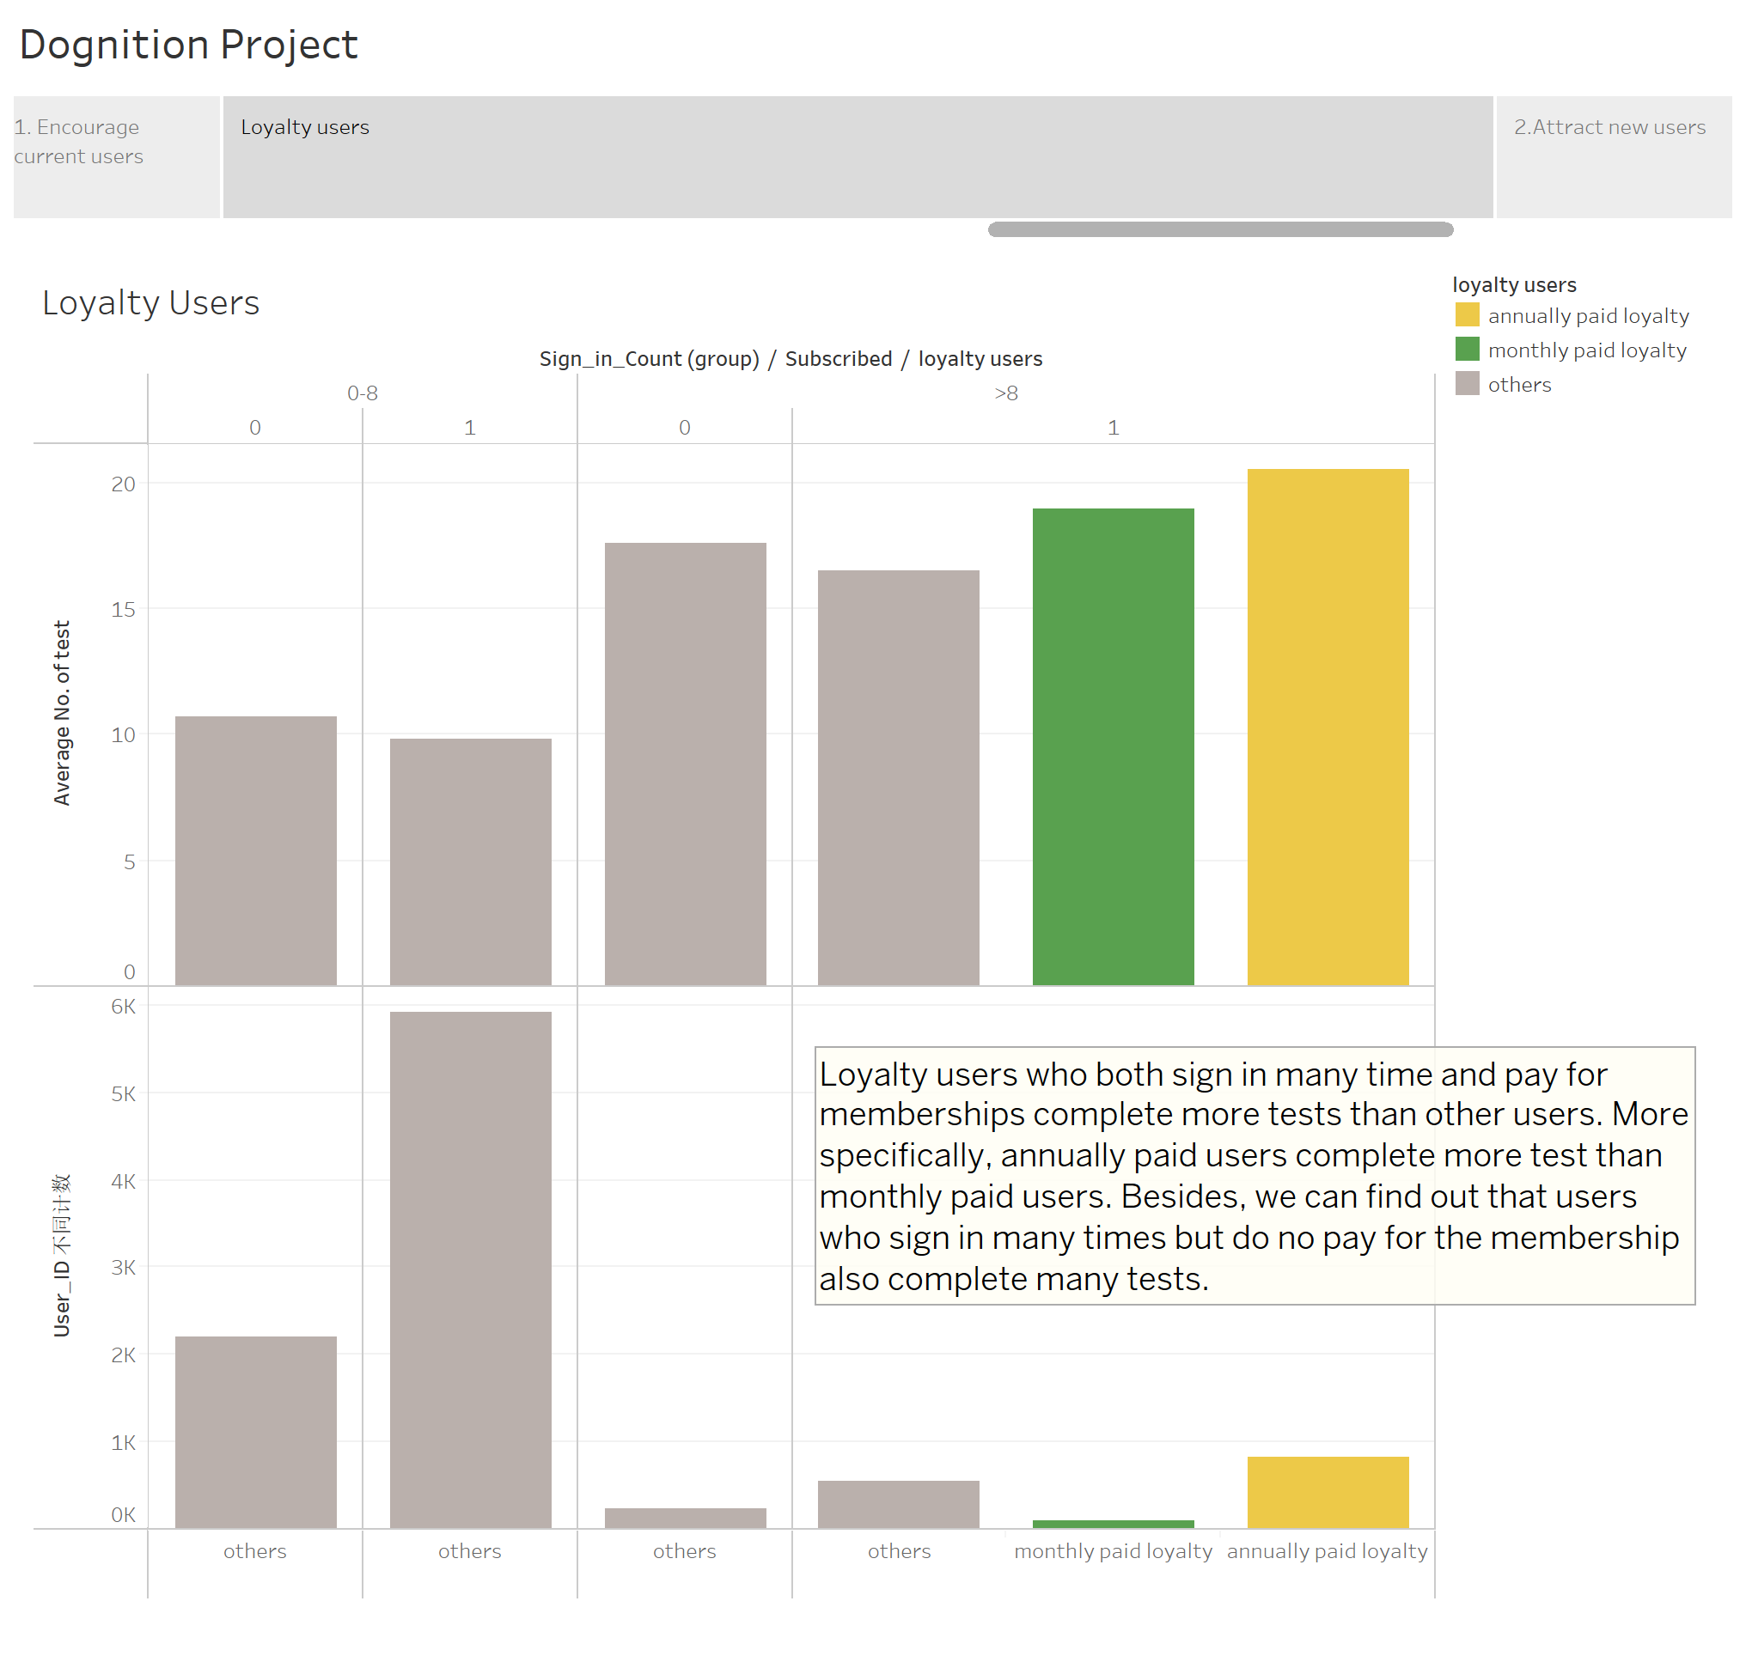

Slide 6
